Slide 1



ABC Call Volume Trend Analysis
Prepared by : Shivam Singh
Email id: Shivamkumsingh@gmail.com

Slide 2

Contents
Project Description
Approach
Tech-Stack Used
Data Analytics Task
Insights
Result and Conclusion

Slide 3

Project Description
In this project, we'll explore the world of Customer Experience (CX) analytics by analyzing data from a company's inbound calling team. We'll work with a dataset covering 23 days of call records, including details like:
Agent information (name and ID)
Queue time (how long customers waited before speaking to an agent)
Call timing (when the call happened)
Call duration (how long the conversation lasted)
Call status (whether it was answered, abandoned, or transferred)
Our goal is to uncover insights that can help improve customer service, optimize agent performance, and enhance overall call center efficiency.

Slide 4
Approach
Data Extraction: Downloaded and Imported the dataset into Excel.
Data Cleaning: Cleaned the data by removing Irrelevant entries and converting into required values.
Analysis: Used Pivot Tables and charts to visualize trends and uncover key insights and analyzed the findings and compiled them into a report.

Slide 5



Tech-Stack Used
Microsoft Excel 2019: Used for data cleaning and visualizations. Excel provides powerful tools like charts, graphs, pivot tables, and various formatting options that make it easier to analyze and interpret data effectively.
Microsoft PowerPoint 2019: Used for structuring and presenting insights.
Google Drive: Used for storing and sharing reports.

Slide 6
Data Analytics Task
The Dataset contains total of 1,17,988 rows and 13 columns in all and consists of Missing values/Blanks/Null values.
11 columns and 1,17,988 rows were used for analysis after doing data cleaning.
All the Insights are based on Sheet – “Cleaned_Dataset”.
Pivot Tables and Formula were used to get all the calculations of the Variables.
Dataset used and the actual analysis done can be find in the link below.
Click here for the Dataset

Slide 7
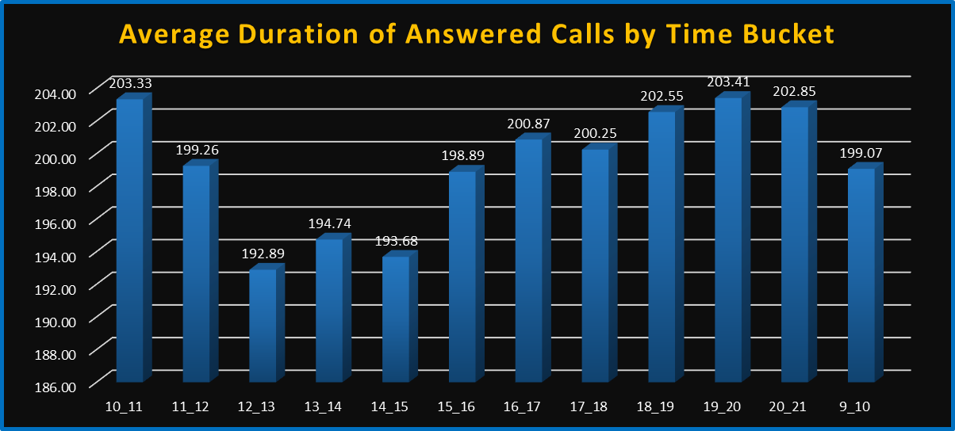
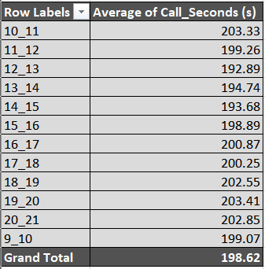
Insights
Average Call Duration: Determine the average duration of all incoming calls received by agents. This should be calculated for each time bucket.
Task: What is the average duration of calls for each time bucket?
Slightly Higher Durations Mid-Morning and Evening:
10–11 AM (203.33 sec) and 7-8 PM (203.41 sec) are the Peak timing.
Lowest Duration Around Lunch:
Noon–1 PM shows the lowest average at 192.89 sec.

Slide 8
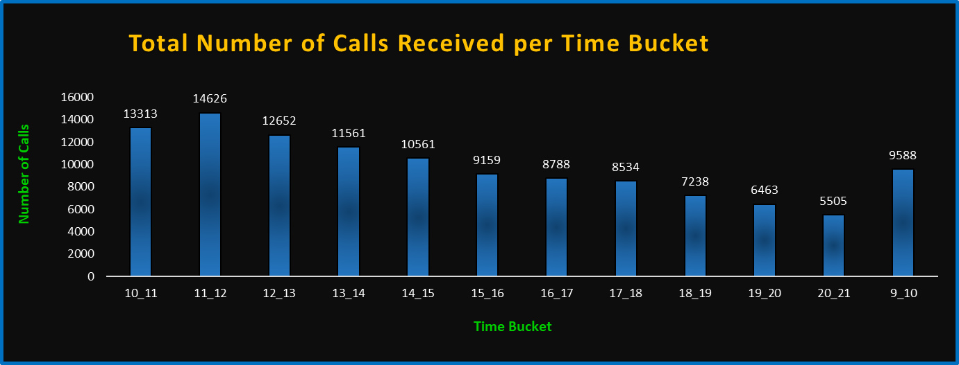
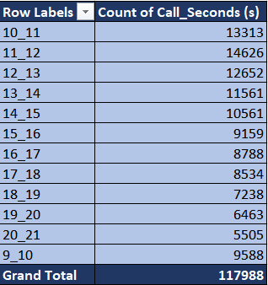

Call Volume Analysis: Visualize the total number of calls received. This should be represented as a graph or chart showing the number of calls against time. Time should be represented in buckets.
Task: Can you create a chart or graph that shows the number of calls received in each time bucket?
Peak Call Hours Are Clearly Identifiable:
Certain time buckets (e.g., 10–11 AM, 11–12 PM) show noticeably higher call volumes.
Lower Volume Periods:
Early hours (e.g., 9–10 AM) and late evening (after 7 PM) show lower call volumes.
Stable Volume Midday:
From 12 PM to 5 PM, call volumes are fairly consistent, suggesting a steady workload.

Slide 9
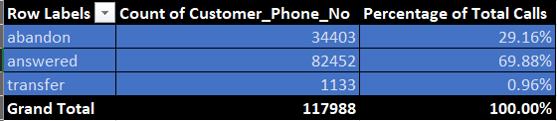
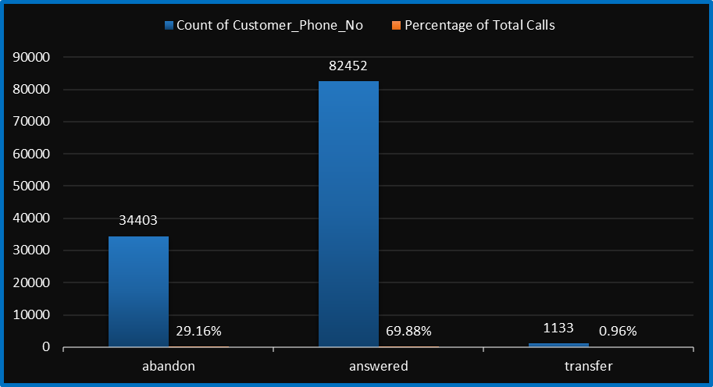
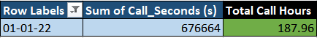
Manpower Planning: The current rate of abandoned calls is approximately 30%. Propose a plan for manpower allocation during each time bucket (from 9 am to 9 pm) to reduce the abandon rate to 10%. In other words, you need to calculate the minimum number of agents required in each time bucket to ensure that at least 90 out of 100 calls are answered.
Task: What is the minimum number of agents required in each time bucket to reduce the abandon rate to 10%?
Assumptions
Description | Value
Total shift | 9 hours
Breaks | 1.5 hours
Actual working time | 7.5 hours
Productive time (60%) | 4.5 hours
Required agent = Total Call Hours​/Agent Productive Time
= 187.96/4.5
= 41.77 ≈ 42
The current answered rate of 70% (since 30% abandon rate).

Slide 10
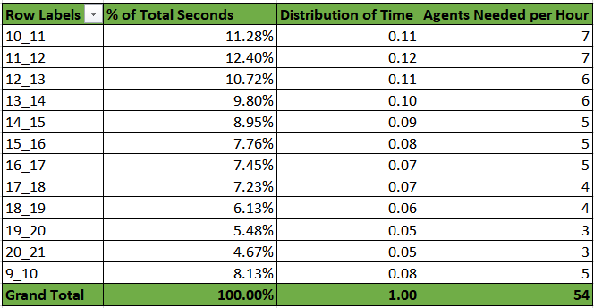
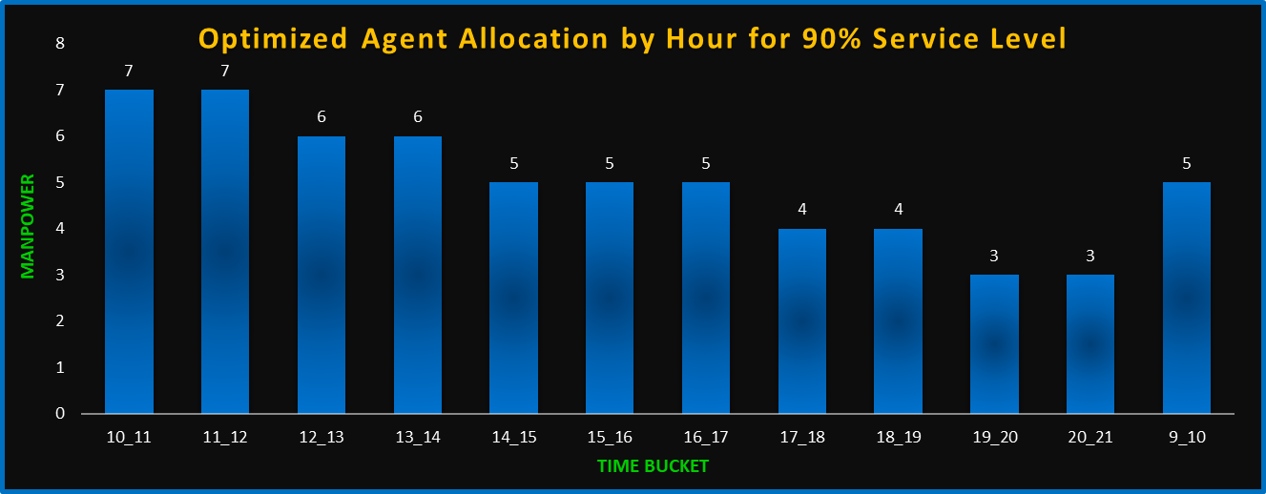
By Using Unitary Method:
42 Agents required for 70 % Abandon rate.
Number of agents required for 90% : 42/70 = x/90
x = (42*90) / 70
x = 54
ROUNDUP formula used for Agents Needed per hour column.
To reduce the call abandon rate from 30% to the target of 10%, a minimum of 54 agents must be allocated throughout the 12-hour operating period (9 AM to 9 PM).
Agent requirements vary by hour based on call volume trends. Peak hours, such as 11 AM to 1 PM, demand the highest staffing, while early morning and late evening slots require fewer agents.

Slide 11
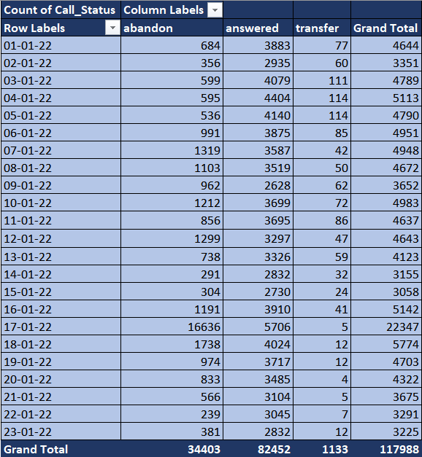
Night Shift Manpower Planning: Customers also call ABC Insurance Company at night but don't get an answer because there are no agents available. This creates a poor customer experience. Assume that for every 100 calls that customers make between 9 am and 9 pm, they also make 30 calls at night between 9 pm and 9 am.
Task: Propose a manpower plan for each time bucket throughout the day, keeping the maximum abandon rate at 10%.
Average Incoming call ( 9 am - 9 pm ) = 117988 /23
= 5130
Average Incoming call between ( 9 pm - 9 am ) 30% of 1530 = 1539
As we know the Agent Working Hours = 4.5
Average call duration in sec =198.6 ( from previous task )
Average Sec required to answer the calls =
( Avg. incoming call at night * Avg. call duration in sec ) = 1539 * 198.6
= 305645
Average Hours required to answer the call = 305645/3600
= 85
Additional hours for 90% of night calls = 0.9*85
= 76.4
Number of Agent required to answer the calls = 76.4 / 4.5
= 16.98 ≈ 17

Slide 12
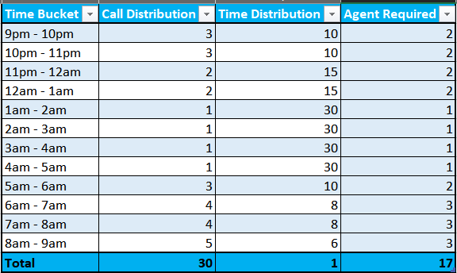
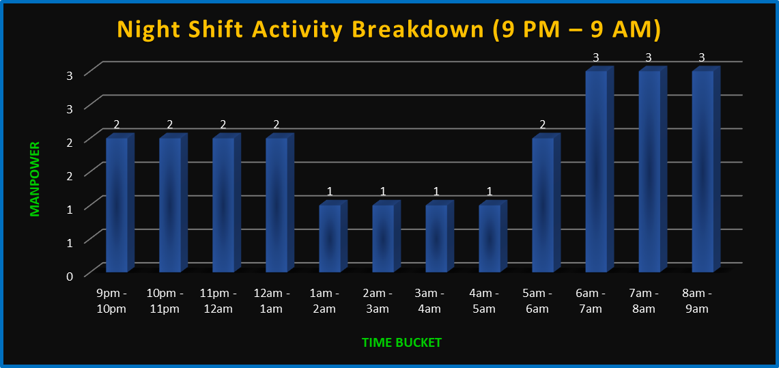
ROUNDUP formula used for Agent Required column.
Higher Manpower at Start and End of Shift:
There is a peak in manpower at the beginning (9–12 AM) and again toward the end of the shift (6–9 AM).
The highest activity is recorded between 6 AM – 9 AM, suggesting preparation for or transition into the day shift.
Minimal Manpower During Midnight to Early Morning:
From 1 AM to 5 AM, manpower remains consistently low (only 1 person per hour block).
This may indicate lower operational demands or reduced workload during these hours.

Slide 13

Results and Conclusion
Call Duration Trends:
Average call durations are longest between 10 AM to 1 PM, peaking around 203 seconds during 10–11 AM.
This suggests that customer issues during this time may be more complex or require more detailed support.
Call Volume Patterns:
The highest number of calls are received between 10 AM and 1 PM, with a peak of 14,626 calls between 11–12 PM.
Call volume declines steadily after 1 PM, indicating the first half of the day is the busiest.
Call Outcomes:
69.9% of calls were answered, while 29.1% were abandoned.
Only a small percentage (0.96%) were transferred, suggesting most issues are resolved in the first contact.
Manpower Planning (Day Shift):
The highest agent requirement is between 10 AM and 12 PM (7 agents).
Fewer agents are needed in the afternoon (around 6 agents from 12 PM to 2 PM).
Night Shift Planning:
Call activity is lower but still consistent during night hours.
The required staffing for night shifts ranges between 1 to 2 agents per hour, depending on the time slot.
The busiest night periods are from 9 PM to 11 PM.
After the analysis we conclude that 10 AM to 1 PM is the peak period for both call volume and duration, requiring the highest agent allocation. A significant 29.1% call abandonment rate indicates a need to improve responsiveness during these hours. Afternoon and night shifts have lower volumes, allowing for reduced staffing. Aligning manpower with demand will enhance efficiency and reduce missed customer interactions.

Slide 14


